Slide 1
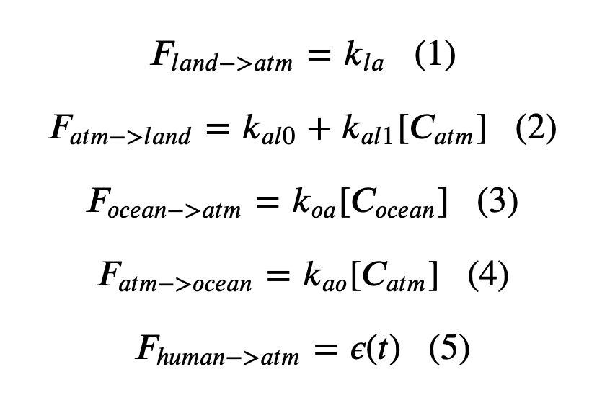
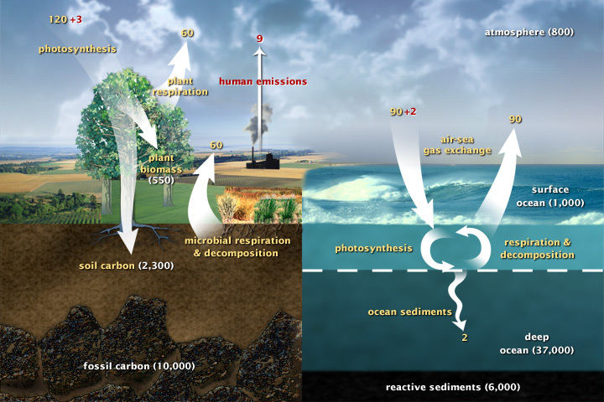
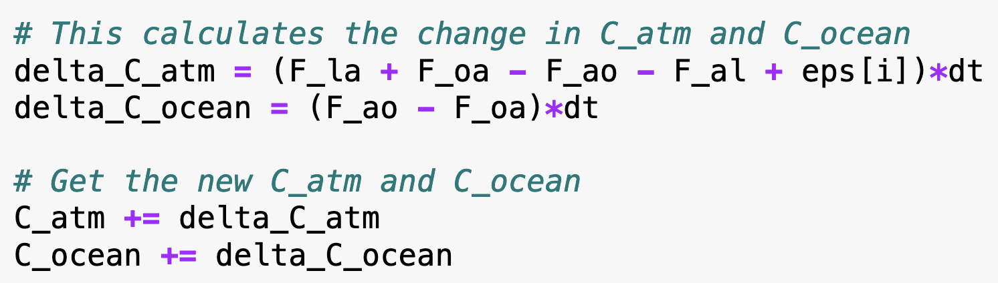
Recap: Cambio1.0
In an Euler loop, we calculated fluxes
From the fluxes we found changes in the amount of carbon in the atmosphere and oceans:

Slide 2
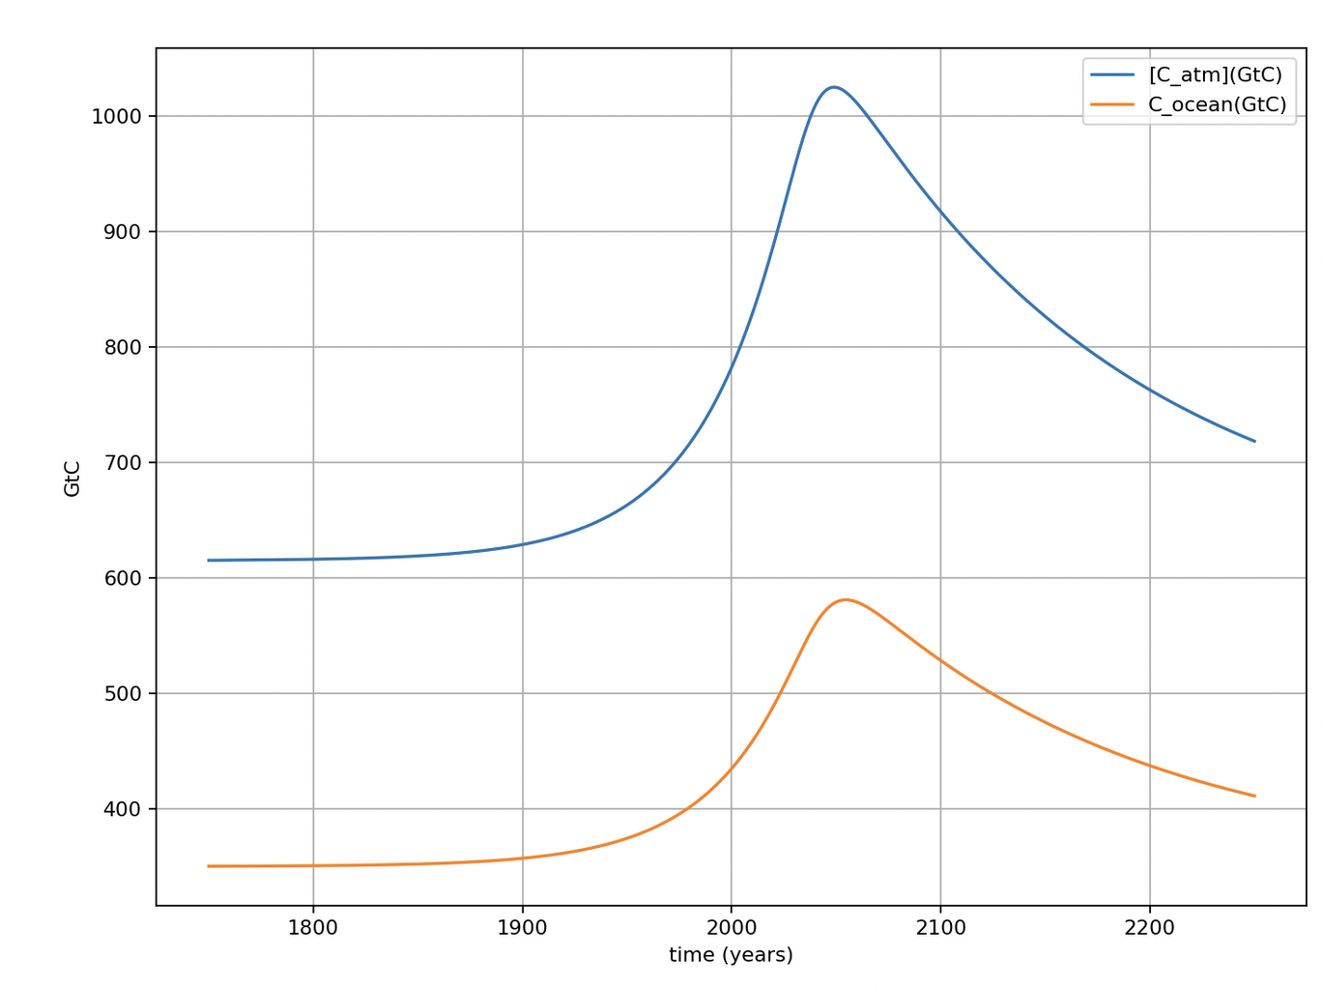
That led to a timeline of amounts in the atmosphere and the upper ocean
Pre-industrial carbon amounts

Slide 3
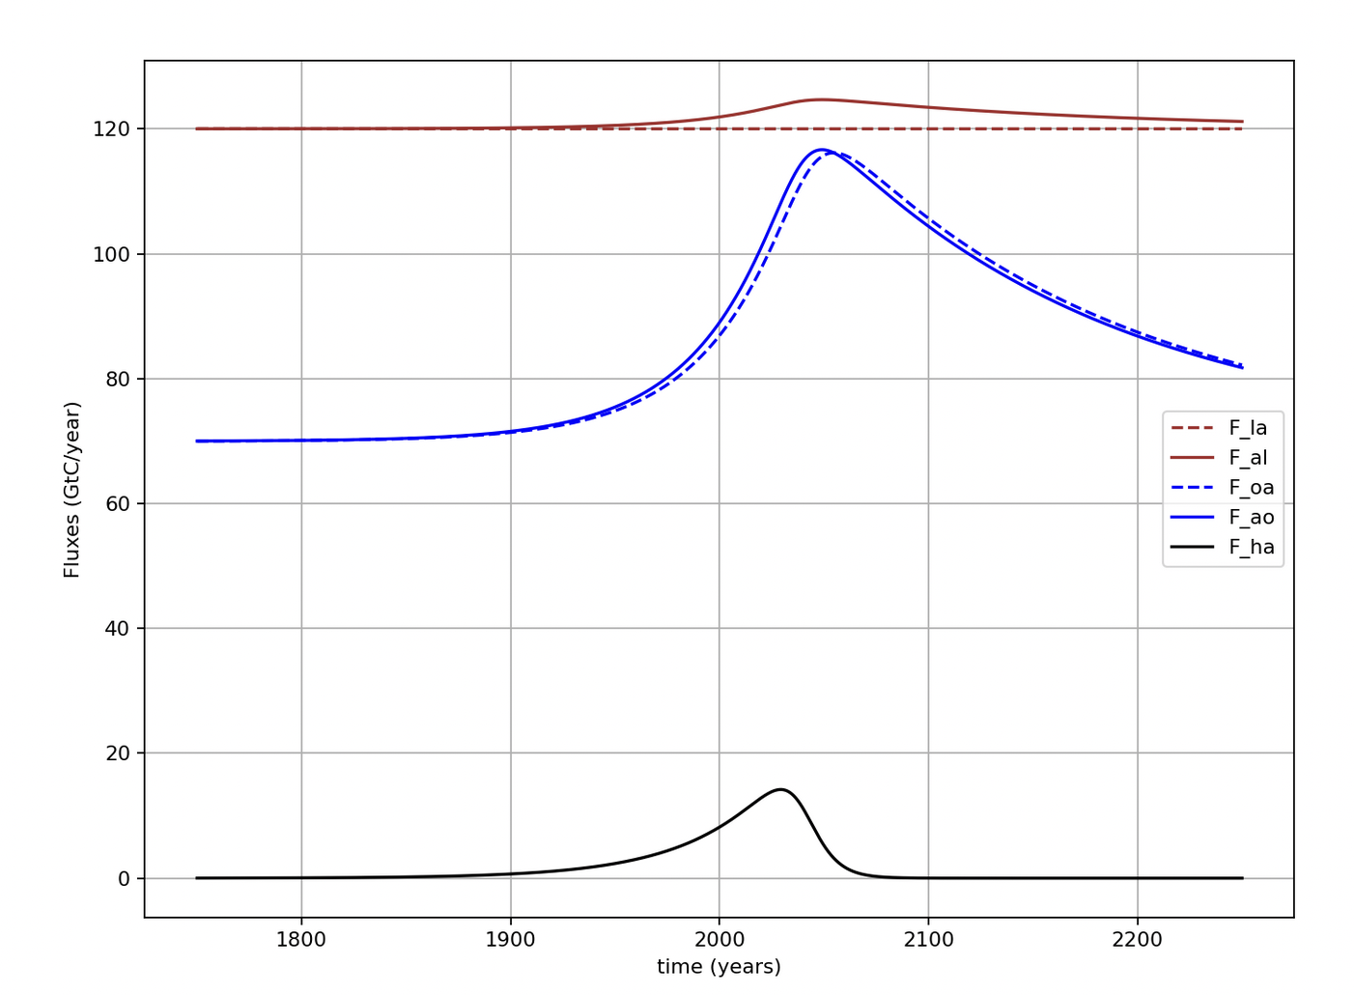
We’ve also looked at net atm/ocean flux (difference between F_oa and F_ao)

Slide 4
And at net atm/land flux (difference between F_la and F_al)

Slide 5
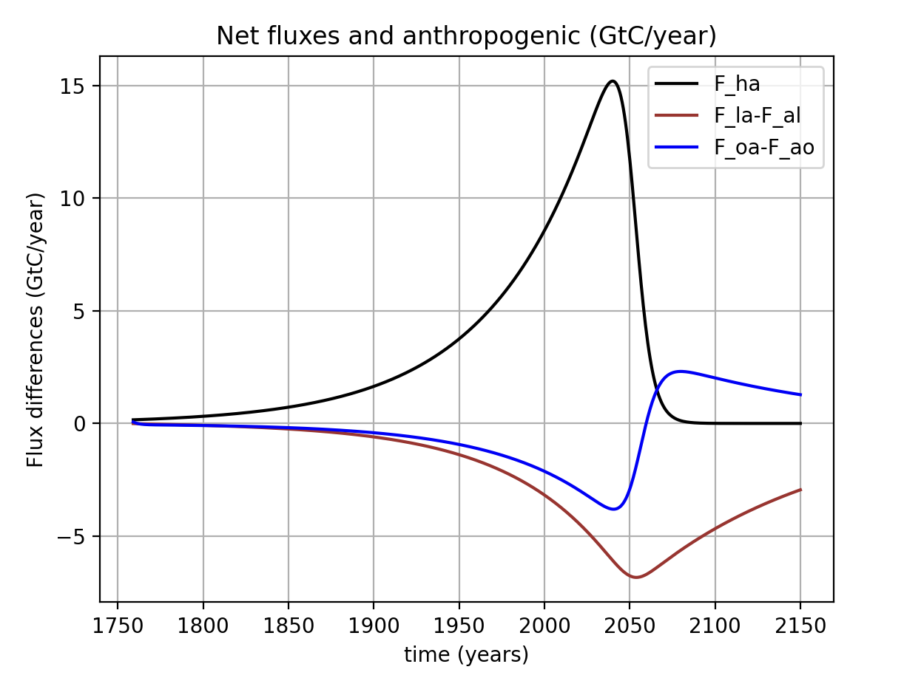
For decades, observations have shown (and Cambio agrees) that the combined net flux (land and oceans) has been about ½ of the annual anthropogenic flux to atmosphere
We can say that these sinks are Earth’s ”free” ecosystem service, although we’ll see limits to that: in Cambio 2., for example, oceans with higher temperature tend to be less able to hold on to CO2, shifting equilibrium toward the atmosphere.

Slide 6
Cambio also predicts that oceans are not a permanent sink, but rather temporary storage.
This reversal is because the climate seems to be on a path back to something like pre-industrial: As carbon amounts in the atmosphere return to normal, the supersaturated oceans begin to give up some of their excess carbon.
Oceans become a net source of carbon around mid-century
Peak backlash (net ocean-to-atmosphere flux is a maximum)
Pre-industrial carbon amounts

Slide 7
Plan for the day
Talk about the difference between kinds of variables in Cambio 1.0: parametric, prognostic, and diagnostic
Introduce the function cl.CreateClimateParams that creates a Python dictionary that specifies a bunch climate parameters (so you don’t have to do it)
Set up functions to calculate (“diagnose”) variables.

Slide 8
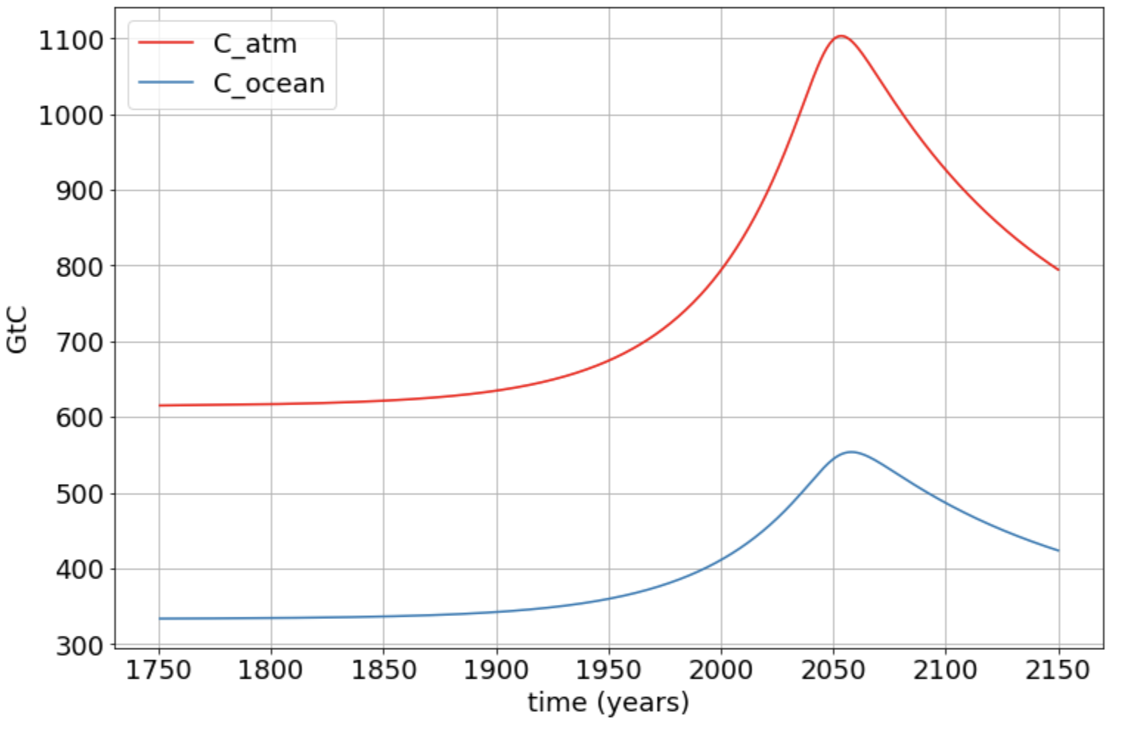
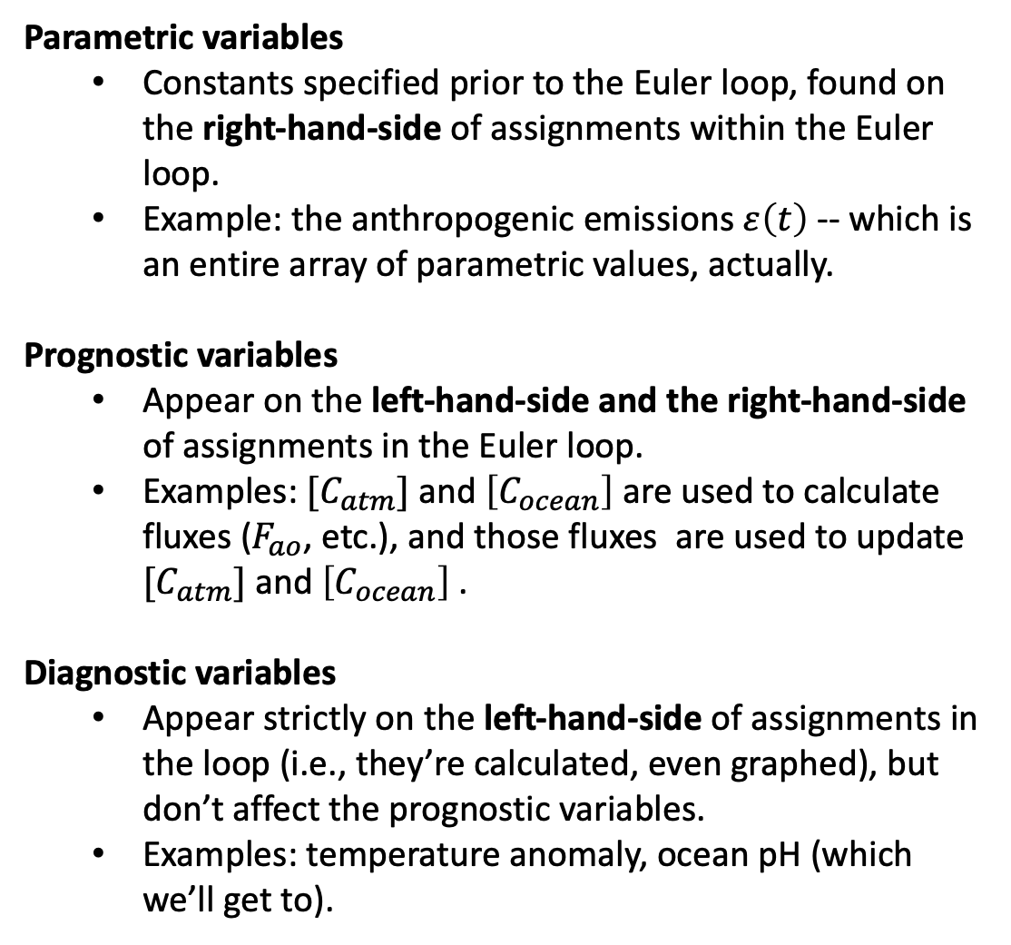
Different kinds of quantities in Cambio 1.0
Parametric variables
Constants specified prior to the Euler loop, found on the right-hand-side of assignments within the Euler loop.
Example: the anthropogenic emissions $ε\left(t\right)$ -- which is an entire array of parametric values, actually.
Prognostic variables
Appear on the left-hand-side and the right-hand-side of assignments in the Euler loop.
Examples: $[C_{atm}]$ and $\left[C_{ocean}\right]$ are used to calculate fluxes ($F_{ao}$, etc.), and those fluxes are used to update $[C_{atm}]$ and $\left[C_{ocean}\right]$.
Diagnostic variables
Appear strictly on the left-hand-side of assignments in the loop (i.e., they’re calculated, even graphed), but don’t affect the prognostic variables.
Examples: temperature anomaly, ocean pH (which we’ll get to).

Slide 9
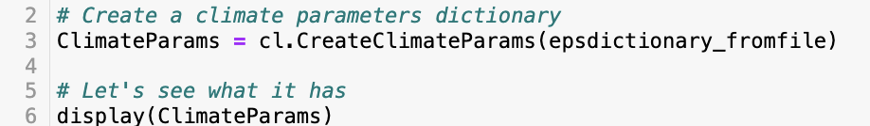
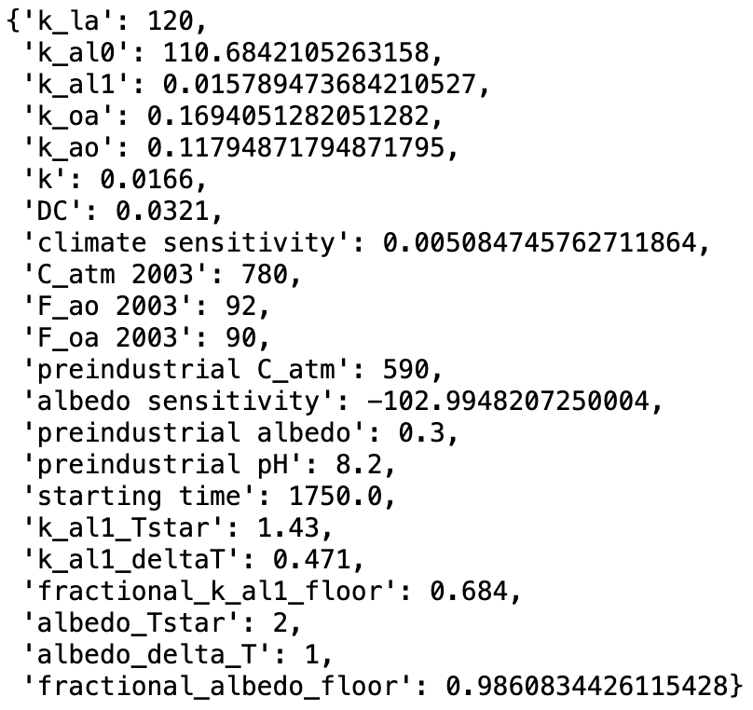
CreateClimateParams: a function that creates a “dictionary” to help keep things organized

Slide 10
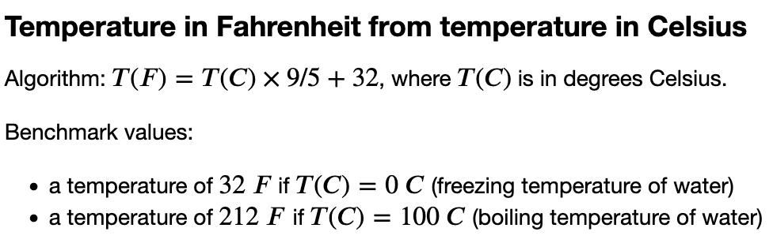
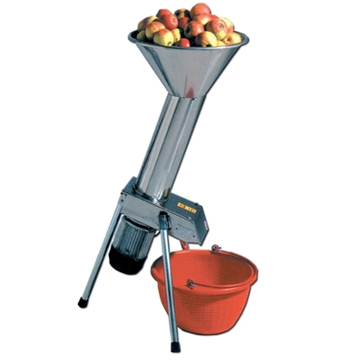
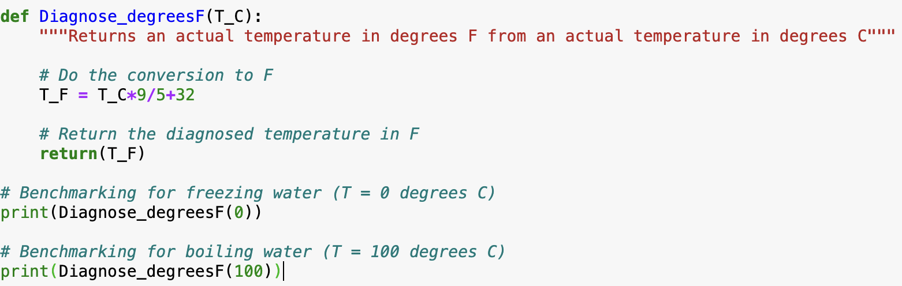
Setting up diagnostic functions: Temperature conversion
T_C goes in
T_F comes out

Slide 11
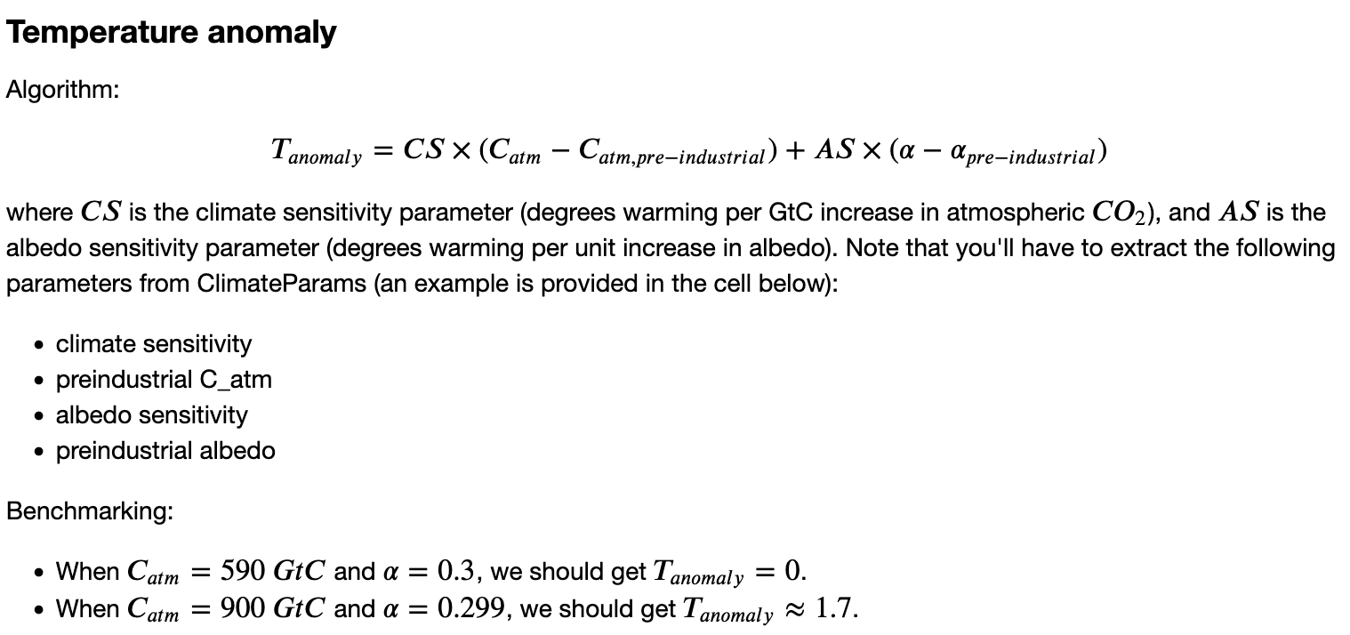
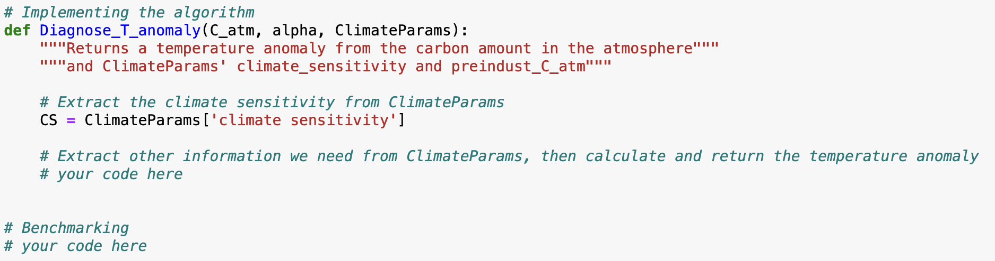
Setting up diagnostic functions: Temperature conversion
C_atm, alpha, and ClimateParams go in
T_anomaly comes out

Slide 12
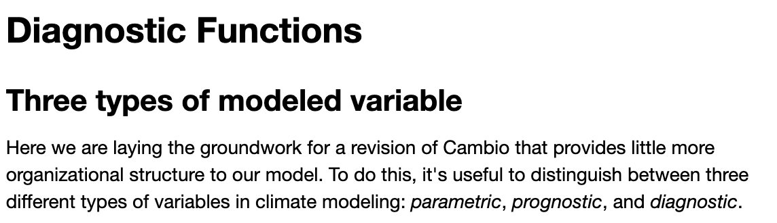
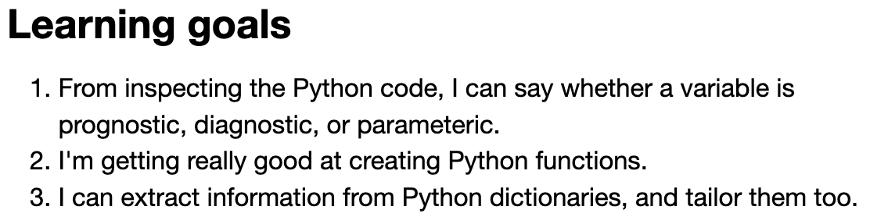
OK, let’s get started …

